Slide 1
IMPUTATION METHODS
Hanadi Bin Mujalli
MISK-DSI 2022

Slide 2
TABLE OF CONTENTS
01
02
03
Introduction
04
Imputation Example
Missing Data
Pattern
Imputation Methods

Slide 3
Introduction
01

Slide 4
Introduction
Missing value is one of the data quality challenges.
High data quality standards are important in machine learning applications to ensure a robust predictive performance and decision making.
Some reasons for missing data are:
Accidentally not recording the data.
Intentionally not filled in by users.
Finding a suitable imputation method for all types of dataset is very challenging.
(Jäger et al., 2021)
(Khan & Hoque, 2020)

Slide 5
Missing Data Pattern
02

Slide 6
Missing Data Types
Missing Completely at Random (MCAR)
Missing at Random (MAR)
Missing Not at Random (MNAR)
Missing independently of any other value
Values are missing depending on another value (e.g., height & gender)
Values are missing depending on their value (e.g., small height values are missing)
(Jäger et al., 2021)

Slide 7
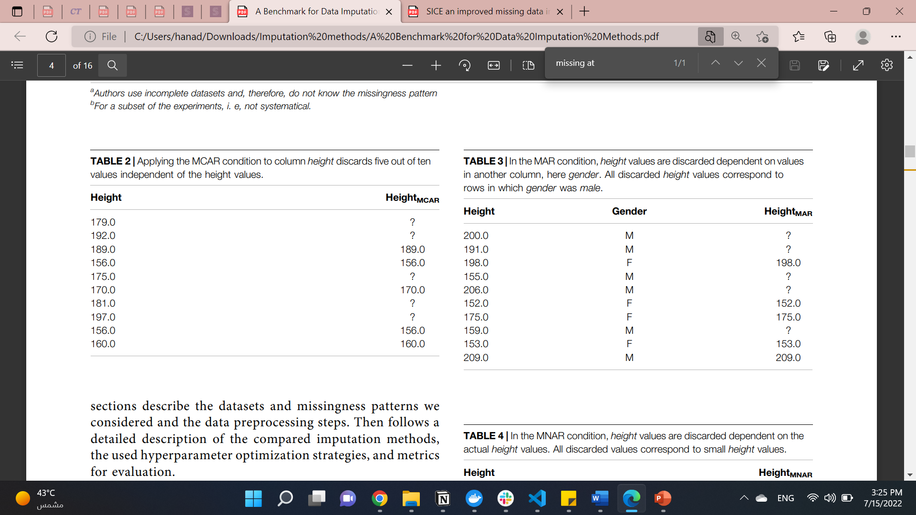
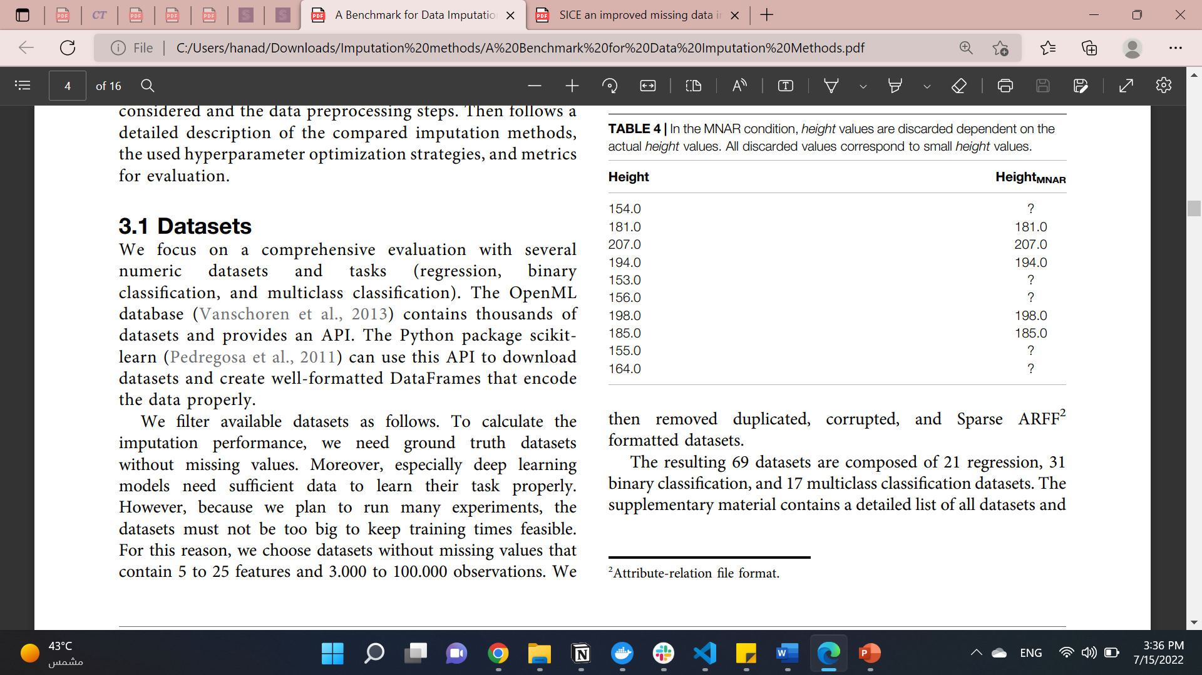
Missing Data Types
Missing Completely at Random (MCAR)
Missing at Random (MAR)
Missing Not at Random (MNAR)
(Jäger et al., 2021)
Notes:
The missingness pattern most often used in the literature on missing value imputation is MCAR. Here, the missing values are chosen independently at random. Usually, the implementations of this condition draw a random number from a uniform distribution and discard a value if that random number was below the desired missingness ratio. Few studies report results on the more challenging conditions MAR and MNAR. We here aim for realistic modeling of these missingness patterns inspired by observations in large-scale real-world datasets as investigated in the work of Biessmann et al. (2018). We use an implementation proposed in the work of Schelter et al. (2020) and Schelter et al. (2021), which selects two random percentiles of the values in a column, one for the lower and the other for the upper bound of the value range considered.
In the MAR condition, we discard values if values in a random other column fall in that percentile.
In the MNAR condition, we discard values in a column if the values themselves fall in that random percentile range

Slide 8
Imputation Methods
03

Slide 9
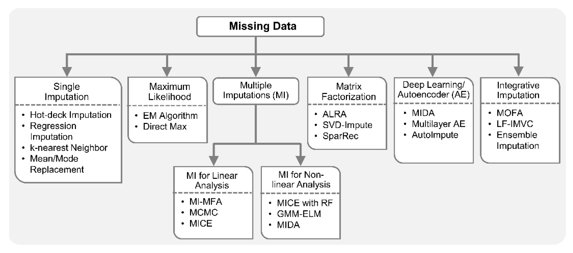
A lot of Methods…
(Mirza et al., 2019)

Slide 10
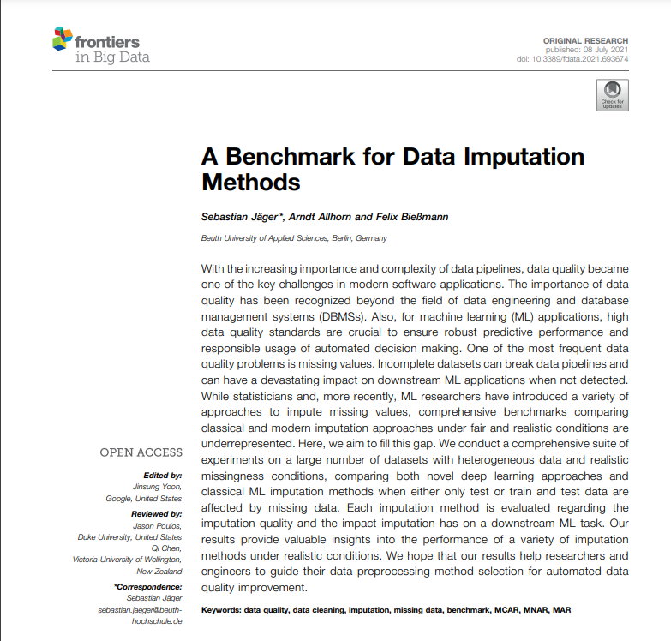
Benchmark for imputaion methods?
“Which imputation method consistently performs best in a large spectrum of application scenarios and datasets under realistic missingness conditions?”
(Jäger et al., 2021)

Slide 11
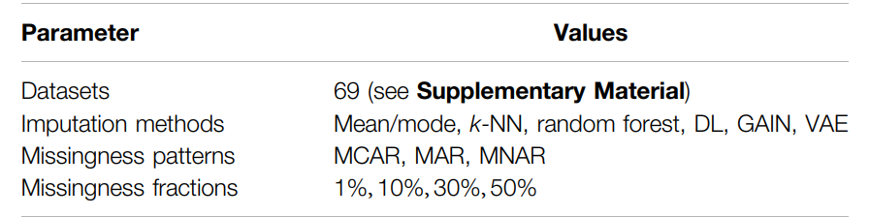
Article Summary
1) Heterogenous datasets with numeric and categorical columns.
2) 21 regression, 31 binary classification, and 17 multiclass classification tasks.
3) Realistic missingness patterns with diffrent missing values.
4) Six imputation methods and optimized hyperparameters.
5) Evaluation on imputation quality and impact on downstream task performance.
6) Training on complete and incomplete data.
(Jäger et al., 2021)
Notes:
Comprehensive benchmark imputation method with respect to:
1- They used 69 as you can see on the table down here
2-Varying ML tasks
3-As you can see in the table, they used MCAR, MAR, and MNAR missingness patterns and 1%, 10%, 30%, and 50% missing values
4- Discriminative Deep Learning, Variational Autoencoder, Generative Adversarial Network.
5-For imputation quality used: root mean square error (RMSE) and macro F1-score (number of TP/ FP , and FN).
downstream task performance.
The percent change of the imputation over the incomplete data relative to the baseline performance on fully observed test data:
the percent change of the imputation over the incomplete data relative to the downstream task performance on incomplete data:
6-

Slide 12
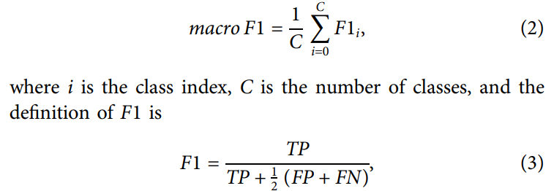
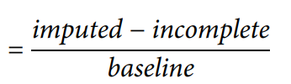
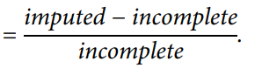
Experimental Procedure Summary
4 parts
Imputation Quality
Downstream Task
Scenario 1 (Complete training data): missing data in test only.
Evaluate: (RMSE) and macro F1-score
Scenario 1 (Complete training data): missing data in test only.
Evaluate:
Scenario 2 (Incomplete training data) test data & training data are missing.
Evaluate:
Scenario 2 (Incomplete training data) test data & training data are missing.
Evaluate: (RMSE) and macro F1-score
(Jäger et al., 2021)

Slide 13
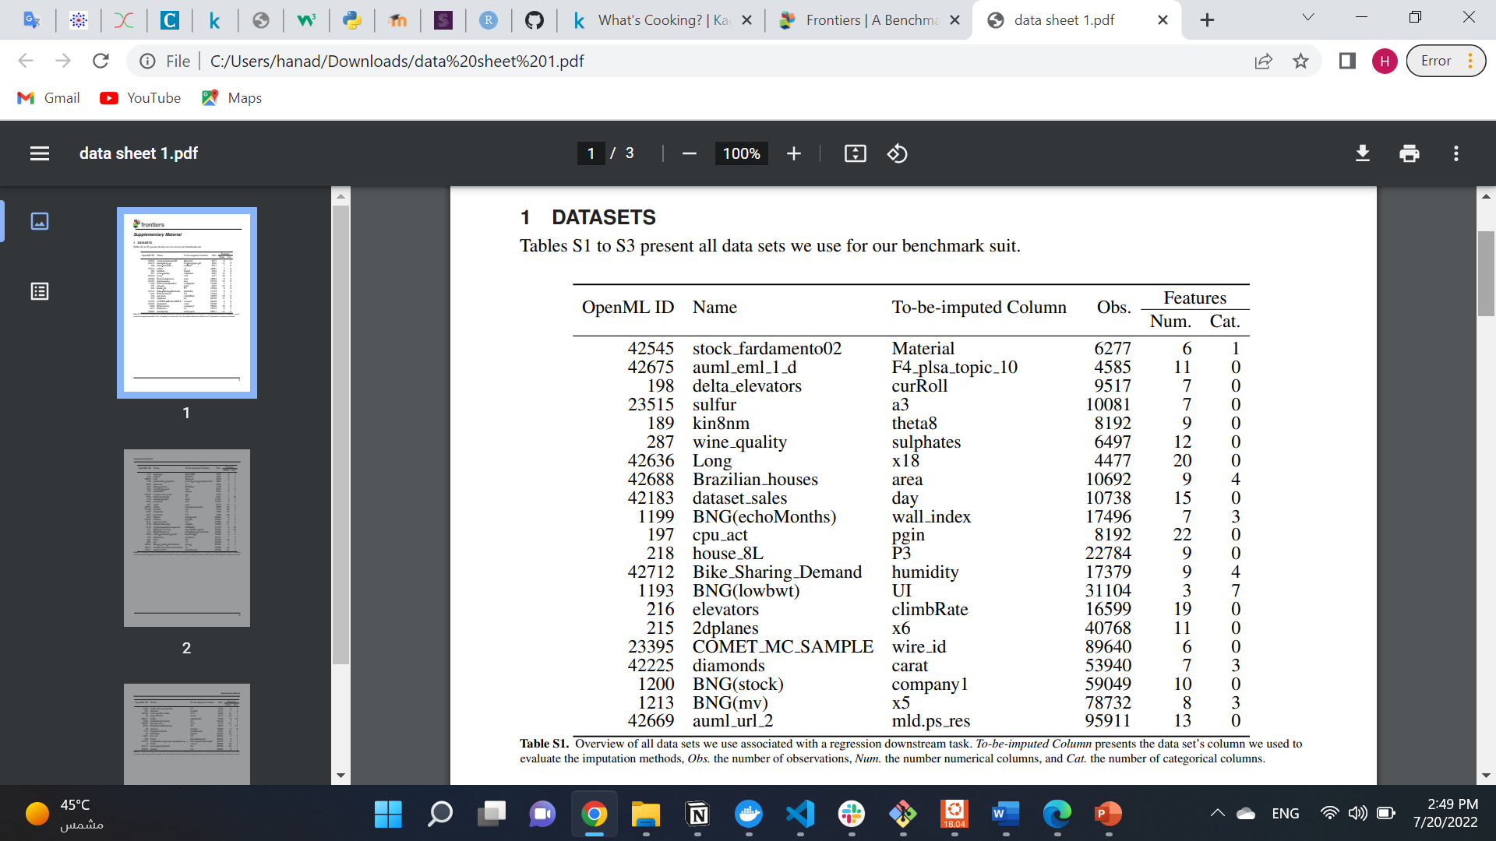
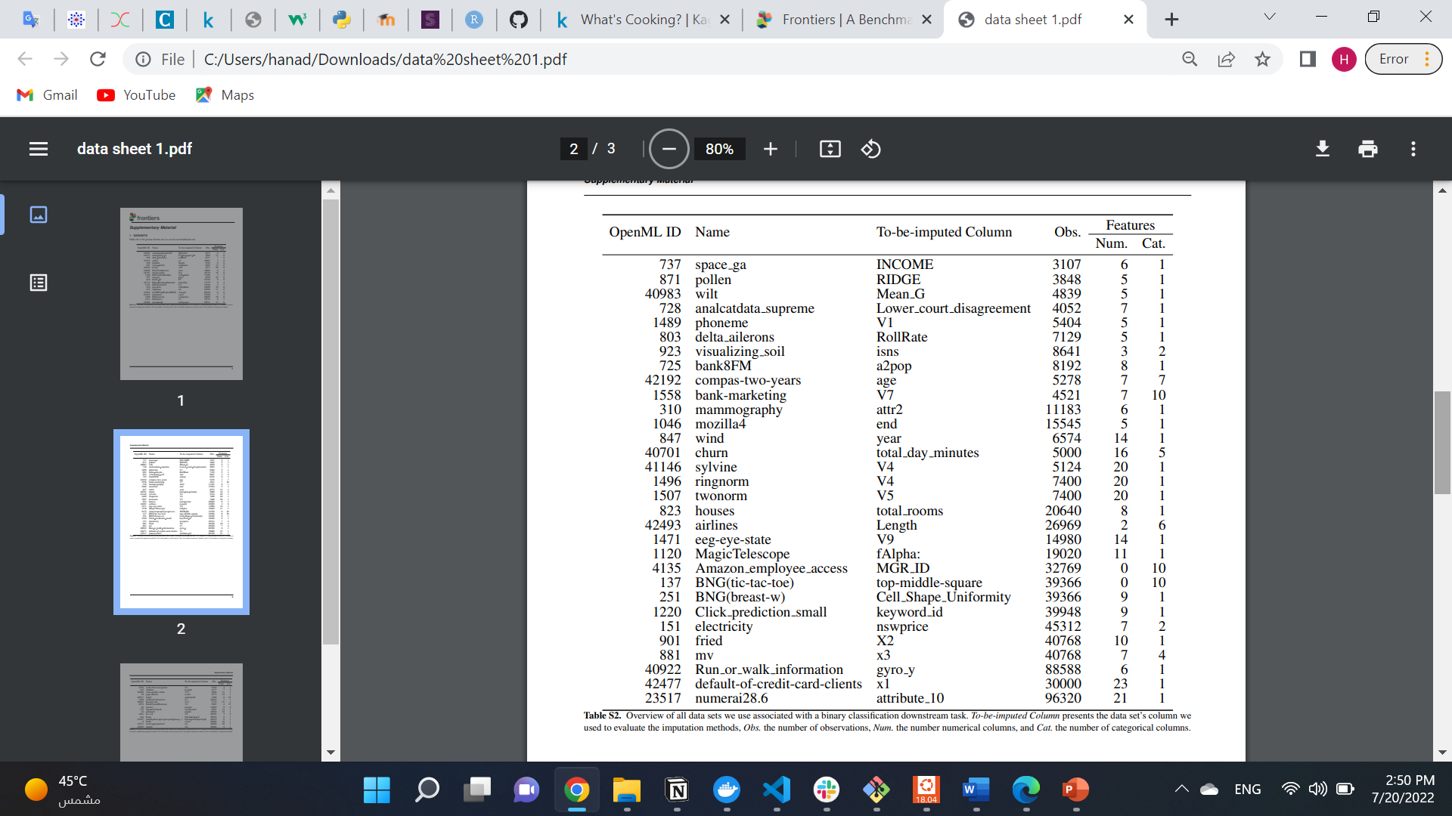
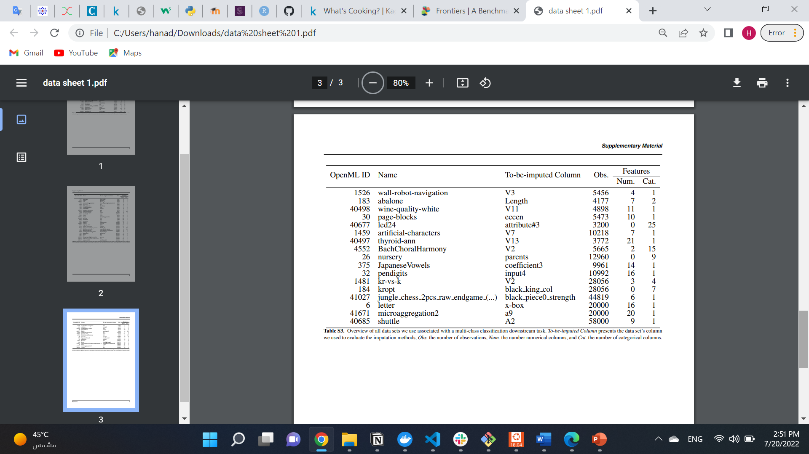
Datasets used in that article?
Datasets that has no missing values and contain 5 to 25 features and 3.000 to 100.000 observations.
(Jäger et al., 2021)

Slide 14
Imputation Methods Used
Mean/Mode
K-NN
1
Mean for numerical and
mode for categorical columns.
2
Used scikit-learn’s
KNeighborsClassifier for categorical and KNeighborsRegressor for numerical columns.
Random Forest
Discriminative Deep Learning
3
Used scikit-learn’s RandomForestClassifier for categorical and
RandomForestRegressor for numerical columns.
4
Used (AutoML) library autokera. StructuredDataClassifier for categorical columns and StructuredDataRegressor for numerical columns.
Variational Autoencoder
Generative Adversarial Network
5
6
Generative Deep Learning methods
Generative Deep Learning methods
(Jäger et al., 2021)
Notes:
Difinitions:
Mean: average
Mode: the most frequent variable
K-NN: Each missing feature is imputed using values from n_neighbors nearest neighbors that have a value for the feature. The feature of the neighbors are averaged uniformly or weighted by distance to each neighbor. (Pedregosa et al., 2011). https://scikit-learn.org/stable/modules/impute.html
Random forest: Fits a number of classifying decision trees on various sub-samples of the dataset and uses averaging to improve the predictive accuracy and control over-fitting (Pedregosa et al., 2011).
Random Forest is an ensemble technique capable of performing both regression and classification tasks with the use of multiple decision trees and a technique called Bootstrap and Aggregation, commonly known as bagging. The basic idea behind this is to combine multiple decision trees in determining the final output rather than relying on individual decision trees ("Random Forest Regression in Python - GeeksforGeeks", 2022).
In the case of a classification problem, the final output is taken by using the majority voting classifier. In the case of a regression problem, the final output is the mean of all the outputs. This part is called Aggregation ("Random Forest Regression in Python - GeeksforGeeks", 2022).
Discriminative Deep Learning
autokeras StructuredDataClassifier
discriminative model makes predictions on the unseen data based on conditional probability and can be used either for classification or regression problem statements. On the contrary, a generative model focuses on the distribution of a dataset to return a probability for a given example ("Deep Understanding of Discriminative and Generative Models", 2022).
VAEs learn to encode their input into a distribution over the latent space and decode by sampling from this distribution (Jäger et al., 2021).
GANs consist of two parts—a generator and a discriminator (Goodfellow et al., 2014). In an adversarial process, the generator learns to generate samples that are as close as possible to the data distribution, and the discriminator learns to distinguish whether an example is true or generated.
The generator’s input is the concatenation of the input data and a binary matrix that represents the missing values.
The discriminator learns to reconstruct the mask matrix. Its input is the concatenation of the generator’s output and a hint matrix, which reveals partial information about the missingness of the original data (Jäger et al., 2021).
References:
Pedregosa, F., Varoquaux, G., Gramfort, A., Michel, V., Thirion, B., & Grisel, O. et al. (2011). Scikit-learn: Machine Learning in Python. Jmlr.csail.mit.edu. https://jmlr.csail.mit.edu/papers/v12/pedregosa11a.html
Random Forest Regression in Python - GeeksforGeeks. (2022). Retrieved 23 July 2022, from https://www.geeksforgeeks.org/random-forest-regression-in-python/?ref=lbp
Deep Understanding of Discriminative and Generative Models. (2022). Retrieved 23 July 2022, from https://www.analyticsvidhya.com/blog/2021/07/deep-understanding-of-discriminative-and-generative-models-in-machine-learning/

Slide 15
Article’s Conclusion?
Imputation helps increasing the downstream predictive performance drastically regardless of the missingness conditions.
Random forest–based imputation had the best imputation quality and the best improvements on the downstream predictive performance.
(Jäger et al., 2021)

Slide 16
Article’s Limitation?
Some of the limitation include:
Focused on point estimates of imputed values rather than multiple imputations.
Removed and imputed values in only one column. Therefore, the impact depends mostly on the chosen column’s importance.
(Jäger et al., 2021)
Notes:
In multiple imputation (MI) one replaces missing values with multiple predictions from an imputation model. Those M > 1 complete datasets can be used to assess the uncertainty of imputed values. The most popular and widely used MI technique is multiple imputation by chained equations (MICE). Note, however, that all the experiments conducted in this work could, in principle, also be evaluated with respect to their uncertainty estimates in a MICE setting, using the examined imputation methods as the model underlying the MICE estimator..
(Jäger et al., 2021).
Single imputation based missing data handling methods are easy to implement but may provide biased imputations, according to statisticians. On the other hand, multiple imputation based methods consider the uncertainty of a dataset and generate a set of plausible values for each missing data, which are complex to implement (Khan & Hoque, 2020)
.

Slide 17
Imputation Example
04

Slide 18
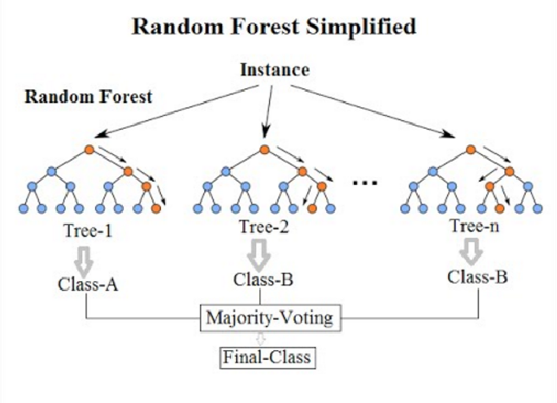
The Idea behind Random Forest
(Kampen, 2019)
Notes:
https://www.youtube.com/watch?v=sQ870aTKqiM&t=0s ((corrected video))
https://www.youtube.com/watch?v=nyxTdL_4Q-Q&t=0s
Ref for that:
https://statquest.org/statquest-random-forests-part-2-missing-data-and-clustering/

Slide 19

Random Forest Imputation in R (rfImpute)
The algorithm starts by imputing NAs using na.roughfix.
Then randomForest is called with the completed data.
The proximity matrix from the randomForest is used to update the imputation of the NAs.
For continuous predictors, the imputed value is the weighted average of the non-missing observations, where the weights are the proximities.
For categorical predictors, the imputed value is the category with the largest average proximity.
This process is iterated (default iter=5, ntree=300).
(Liaw, n.d.)
Notes:
Rough Imputation of Missing Values (A completed data matrix or data frame. For numeric variables, NAs are replaced with column medians. For factor variables, NAs are replaced with the most frequent levels (breaking ties at random).)

Slide 20
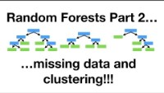
Video Explain
(Starmer, 2020)
Notes:
https://www.youtube.com/watch?v=sQ870aTKqiM&t=0s

Slide 21
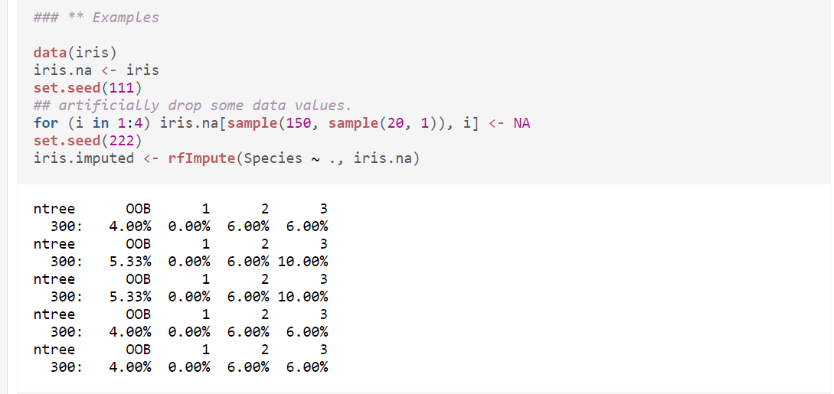
Random Forest Imputation Example
To be predicted by data in all of the columns
Specify the dataset
(Liaw, n.d.)
Notes:
The out-of-bag (OOB) error is the average error for each zi calculated using predictions from the trees that do not contain zi in their respective bootstrap sample
(Pedregosa et al., 2011).
Pedregosa, F., Varoquaux, G., Gramfort, A., Michel, V., Thirion, B., & Grisel, O. et al. (2011). Scikit-learn: Machine Learning in Python. Jmlr.csail.mit.edu. https://jmlr.csail.mit.edu/papers/v12/pedregosa11a.html

Slide 22
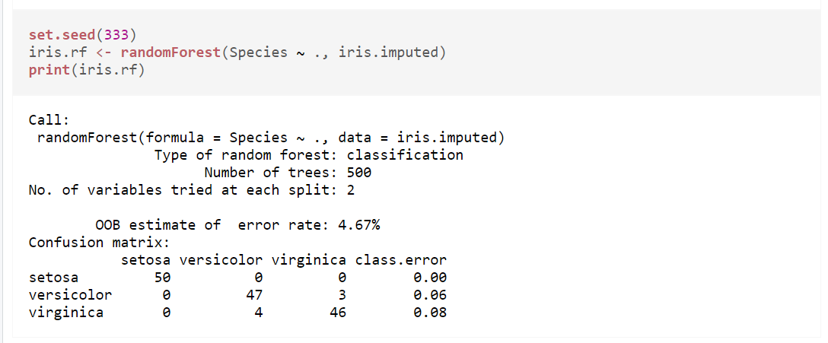
Random Forest Imputation Example
(Liaw, n.d.)

Slide 23
References
Jäger, S., Allhorn, A., & Bießmann, F. (2021). A Benchmark for Data Imputation Methods. Frontiers In Big Data, 4. https://doi.org/10.3389/fdata.2021.693674
Khan, S., & Hoque, A. (2020). SICE: an improved missing data imputation technique. Journal Of Big Data, 7(1). https://doi.org/10.1186/s40537-020-00313-w
Mirza, B., Wang, W., Wang, J., Choi, H., Chung, N. C., & Ping, P. (2019). Machine Learning and Integrative Analysis of Biomedical Big Data. Genes, 10(2), 87. https://doi.org/10.3390/genes10020087
Kampen, C.A. (2019). Missing data imputation based on probabilistic data. https://essay.utwente.nl/79142/1/Missing_data_imputation_based_on_probabilistic_data.pdf
Liaw, A. Missing Value Imputations by randomForest. https://search.r-project.org/CRAN/refmans/randomForest/html/rfImpute.html
Starmer, J. [StatQuest with Josh Starmer]. (2020). StatQuest: Random Forests Part 2: Missing data and clustering [Video]. YouTube. https://www.youtube.com/watch?v=sQ870aTKqiM

Slide 24
THANK YOU
Do you have any questions?
Please keep this slide for attribution

